Slide 1

Hybrid Neural Network: The Ultimate Defender Against Network Intrusion
P. Ganesh Kumar and D. Devaraj[Scopus Indexed]
SAVLEEN KAUR: 2020CSC1034
MEHUL JAIN: 2020CSC1035

Slide 2
Introduction
Network intrusion is a major concern for organizations and individuals alike. Intruders can gain access to sensitive information, disrupt services, and cause damage to systems. Intrusion Detection System (IDS) is a system that identifies, in real time, attacks on a network and takes corrective action to prevent those attacks.Traditional methods of intrusion detection are no longer sufficient in detecting sophisticated attacks. Hybrid neural networks have emerged as a promising solution to this problem.
Hybrid neural networks combine the strengths of different types of neural networks, such as feed forward and recurrent neural networks, to improve accuracy and reduce false positives. They also have the ability to learn from new data and adapt to changing environments.

Slide 3
Types of I ntrusions
Denial of Service (DoS)
It is an attack meant to shut down machine or network making it inaccessible to its intended users. It is accomplished by flooding the target with traffic, or sending it information that triggers a crash.
Remote to User Attacks (R2L)
It is a type of computer network attacks, in which an intruder sends set of packets to another computer or server over a network where he/she does not have permission to access as a local user.
User to Root Attacks (U2R)
It is a type of attack where the intruder tries to access the network resources as a normal user, M.
Probing
It is an invasive method for bypassing security measures by observing the physical silicon implementation of a chip. As an invasive attack, one directly accesses the internal wires and connections of a targeted device and extracts
sensitive information.

Slide 4
Types of Network I ntrusion Detection Systems
There are two main types of network intrusion detection systems: signature- based and anomaly-based. Signature-based systems use predefined patterns or signatures to detect known attacks. Anomaly-based systems, on the other hand, detect deviations from normal behavior by analyzing traffic patterns and system logs.
Hybrid neural networks can be used in both signature-based and anomaly-based systems. In signature-based systems, they can improve accuracy by combining multiple signatures and identifying variations of known attacks. In anomaly-based systems, they can learn normal behavior and detect deviations
from it.

Slide 5
Benefits of Using Hybrid Neural Networks
Hybrid neural networks offer several benefits over traditional intrusion detection systems. They can handle large amounts of data and detect subtle patterns that may be missed by human analysts. They can also learn from new data and adapt to changing environments, making them more effective at detecting unknown attacks.
In addition, hybrid neural networks can reduce false positives by combining the strengths of different types of neural networks. This reduces the workload for human analysts and allows them to focus on investigating actual intrusions.

Slide 6
Challenges in I mplementing Hybrid Neural Networks
Implementing hybrid neural networks for network intrusion detection can be challenging. One of the main challenges is obtaining high-quality training data. The network must be trained on a diverse set of data that covers a wide range of attack scenarios and normal behavior.
Another challenge is ensuring that the network is scalable and can handle large amounts of data in real-time. This requires careful optimization of the network architecture and hardware resources.

Slide 7

This paper presents a novel intrusion detection system based on combining two powerful machine learning techniques: Self-Organizing Maps (SOM) and Back Propagation Network (BPN). The proposed hybrid neural network approach is evaluated on the KDD cup' 99 dataset from the UCI KDD archive.
This dataset includes all kinds of attacks, which are divided into five major categories: Normal, Denial-of-Service (DOS), Probe, User-to-Root (U2R), and Remote-to-Local (R2L). The proposed approach provides an insightful visualization of network intrusion and is successful in detecting different types of attacks.
The SOM and BPN are both powerful machine learning techniques that are often used to detect various types of intrusions.
The SOM is a supervised learning algorithm that is used to map input data into a two-dimensional space in order to visualize patterns and clusters in the dataset.
The BPN is an artificial neural network that is used to classify data based on a set of input features. The proposed hybrid neural network approach combines these two techniques to form an effective intrusion detection system.

Slide 8
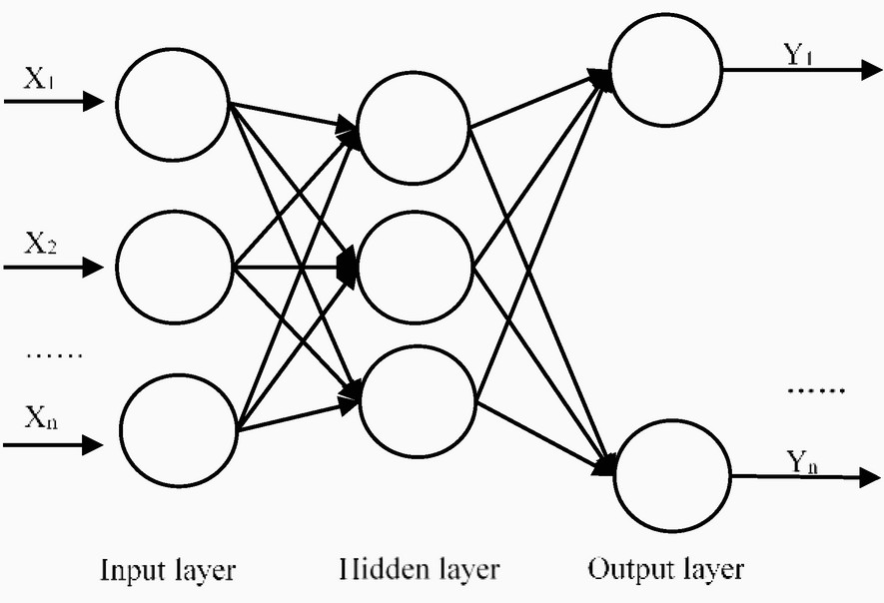
BACK PROPAGATI ON NETWORK(BPN)
Back propagation network is a type of artificial neural network that is commonly used in machine learning and deep learning. It is a supervised learning algorithm that is used for training feedforward neural networks. The back propagation algorithm is used to adjust the weights of the neurons in the network, which helps in reducing the error between the actual output and the desired output.
The architecture of a back propagation network consists of an input layer, one or more hidden layers, and an output layer. The input layer receives the input data, which is then processed by the hidden layers. The output layer produces the final output of the network. Each neuron in the network is connected to other neurons through weighted connections. The weights of these connections are adjusted during the training process using the back propagation algorithm. The number of neurons in the hidden layers and the number of hidden layers can vary depending on the complexity of the problem being solved.

Slide 9
Training a Back Propagation Network
Training a back propagation network involves feeding the input data into the network and comparing the output produced by the network with the desired output. The difference between the two outputs is calculated as the error, which is then used to adjust the weights of the neurons in the network using the back propagation algorithm.
The training process continues until the error between the actual output and the desired output is minimized. Once the network is trained, it can be used to make predictions on new data.
Advantage
One of the main advantages of back propagation network is its ability to learn from examples and generalize to new data. It can handle large amounts of data and can be used for both classification and regression tasks. It is also easy to implement and can be trained using standard optimization techniques.

Slide 10
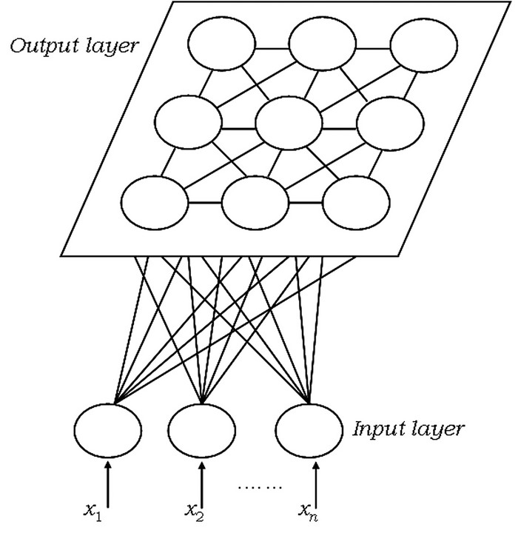
Self Organizing Maps(SOM)
Self Organizing Maps, also known as Kohonen maps, are a type of artificial neural network that can be used for unsupervised learning. They are particularly useful for clustering and visualizing high-dimensional data.
SOMs consist of an input layer, a competitive layer, and an output layer. The input layer receives data from external sources, while the competitive layer contains neurons that compete to respond to the input data.
The output layer is a two-dimensional grid of neurons that represent the final output of the SOM. Each neuron in the output layer is connected to all of the neurons in the competitive layer, and the connections between these neurons are adjusted during training to create a map of the input space.

Slide 11
Training Self Organizing Maps
The process of training a SOM involves randomly initializing the weights of the neurons in the competitive and output layers, and then repeatedly presenting input data to the network. During each iteration, the neuron with the closest weight vector to the input data is selected as the winner, and its weight vector is adjusted to better match the input data.
Over time, the weights of the neurons in the output layer converge to form a topological representation of the input space. This allows similar inputs to be located near each other on the map, making it easy to visualize and analyze complex data sets.

Slide 12
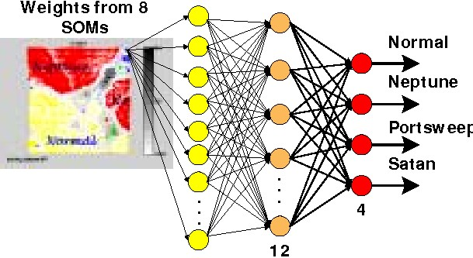
Hybrid SOM_BPN model
The proposed methodology for Intrusion Detection in Computer Networks is based on using Artificial Neural Network (ANN) for detecting the Normal and Abnormal conditions of the given parameters, which leads to various attacks.
The following issues are to be addressed while developing an ANN for Network Intrusion Detection:
A. Selection of input and output variables
In the ANN-based Network Intrusion detection model, the input variables represent a TCP/IP Connection. A Connection is sequence of TCP packets starting and ending at some well defined times, between which data flows to and from a source IP address to a target IP address under some well defined protocol. For each TCP/IP, there are 41 input features.Among them, 32 features are continuous variables and 9 features are discrete variables. The output is labeled as either normal or as an attack, with exactly one specific attack type

Slide 13
B. Data pre pocessing and representation
Before training the neural network, the dataset should be preprocessed to remove the redundancy present in the data and the non-numerical attributes should be represented in numerical form suitably.
In this ANN based Misuse detection model, the output is represented as below [0 0 0 0] —> Normal
[0 0 0 1] —> DOS
[0 0 1 0] —> Probe
[O 1 0 0] —> R2L
[1 0 0 0] —> U2R
C. Data normalization
During training of the neural network, higher valued input variables may tend to suppress the influence of smaller ones.Also, if the raw data is directly applied to the network, there is a risk of the simulated neurons reaching the saturated conditions. If the neurons get saturated, then the changes in the input value will produce a very small change or no change in the output value. This affects the network training to a great extent. To minimize the effects of magnitudes among inputs as well as to prevent saturation of the neuron activation function, the input data is normalized before being presented to the neural network. One way to normalize the data x is by using the expression:
Xn=((X - Xmn ) * range)/(Xmax-Xmin)+ starting value where, Xn, is the normalized value and Xmin and Xmax are the minimum and maximum values of the data.

Slide 14
D. Selection of network structure, training and testing
The proposed hybrid approach uses two different network structures SOM and BPN. Both are Feed Forward Neural Network Structure but uses different learning algorithm and meant for different tasks.
Initially the data set is preprocessed, normalized and fed into SOM network for visualization and dimensionality reduction. The SOM has two modes of operation, during the training process a map is built, the neural network organizes itself, using a competitive process.
The network must be given a large number of input vectors ,as much as possible representing the kind of vectors that are expected during the second phase (if any). Otherwise, all input vectors must be administered several times.
During the mapping process a new input vector may quickly be given a location on the map, it is automatically classified or categorized.
The weight information from the SOM network is used as an input to the BPN network.
To make a Back Propagation Network to perform some specific task, one must choose number of input neurons, output neurons, hidden neurons and how the neurons are connected to one another
There are about forty one neurons in the input layer that corresponds to the number of input features and four neurons in the output layer in which all neurons set to zero corresponds to Normal and one in each neuron corresponds to any one of the four attacks (DOS, Probe, R2L and U2R). The number of hidden units is directly related to the capabilities of the network.
The hidden layer neurons have tangent hyperbolic function as the activation function and the output have linear activation function. Back propagation algorithm that is used to train the network propagates the error from the output layer to the hidden layer to update the weight matrix. After training, the networks are tested with the test data set to assess the generalization capability of the developed network.

Slide 15
SI MULATI ON RESULT
The data set is a version of the 1998 DARPA intrusion detection evaluation data set prepared and managed by MIT Lincoln Labs. In this data set, forty-two attributes (or fields) that usually characterize network traffic behavior compose each record.
Each record contains forty one input features that represents a sequence of TCP packet starting and ending at some well defined times, between which data flows to and from a source IP address to a target IP address under some well defined protocol and one output feature labeled as either normal or as an attack, with exactly one specific attack type. The SOM network is developed using the SOM Toolbox used here is a free function library for MATLAB 6.5 implementing the Self-Organizing Map (SOM) algorithm which is a neural network algorithm based on unsupervised learning.
It performs a vector quantization and simultaneously organizes the quantized vectors on a regular low-dimensional grid To make things easier to the user, the high level functions require minimum number of parameters. For example, SOM size and training parameters are, unless specified, determined automatically based on the training data.
SOM Toolbox has a large number of functions that can be used for preprocessing of the data and post- processing/analyzing the SOM. SOM Toolbox Implementation in MATLAB alllows fast prototyping and powerful visualization

Slide 16
Self organizing map is an unsupervised neural network algorithm. In this work, the training was employed through batch algorithm of SOM to cluster and visualize data. The output weight information from SOM is fed into the backpropagation neural network. The final quantization error is
0.285 and Final topographic error is 0.019. The BPN model used here is a single hidden layer of tansigmoidal neurons, which receives the inputs, then broadcast their outputs to an output layer of linear neurons, which compute the corresponding values.
After training the generalization performance of the network is evaluated with the help of the test data and it shows that the trained ANN is able to produce the correct output even for the new input. After training the network with least error rate, the testing data was fed as input to the network. The testing data comprises of both normal and abnormal data. This shows that the trained neural network model is able to produce the correct output even for the new input.
It is inferred that even though the same approach has been proposed in the literature, the attacks considered vary. All the approaches proposed in the literature considers only selected very few attacks. But here all sorts of attacks (given in section II 4 category of attacks which include 24 number of intrusions) are considered and the proposed approach shows 98.91% of detection rate for all attacks together.

Slide 17
Conclusion
In conclusion, hybrid neural networks offer a powerful solution to the problem of network intrusion detection. While implementing hybrid neural networks for network intrusion detection can be challenging, the benefits outweigh the challenges. Hybrid neural networks have numerous applications in network intrusion detection and can help organizations protect their sensitive information and systems from malicious attacks.
This paper has presented a neural network based approach for Intrusion detection in a network based computer system using Self Organizing Map and Back Propagation network. The bottleneck of any ANN model for intrusion detection is the data set used and the attack considered. The data required for the development of neural network model have been obtained from KDD Cup' 99 data. Totally 4 category of attacks which include 24 number of intrusion from the computer network were considered in the developed model. The SOM network is used to visualize and study the characteristics of each input features and the weight information (Code Book Vectors) from SOM is fed into BPN for classifying the attacks. For all kinds of attacks considered together the network shows the very good detection rate compared to the results reported in the literature.

Slide 18
Thank you!

